Slide 1
Non-structural Measures for Flash Flood and Debris Flow
Disaster Prevention
Sun Dongya
Research Center on Flood and Drought Disaster Reduction (RCDR), MWR
China Institute of Water Resources and Hydropower Research (IWHR)

Slide 2
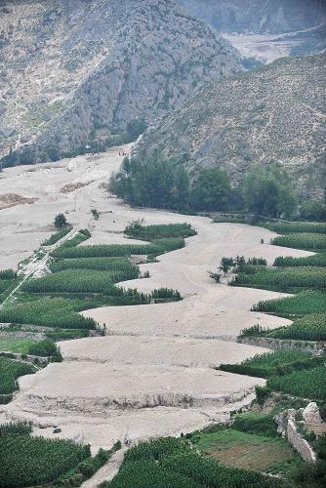
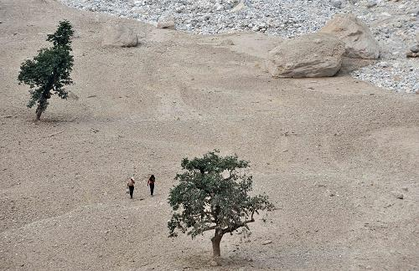
Debris-flow disaster, Zhouqu city of Hansu Province.

Slide 3
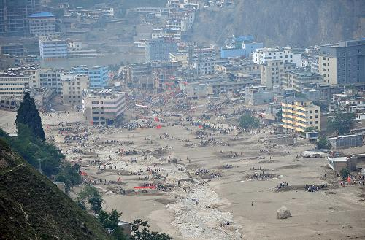

Slide 4
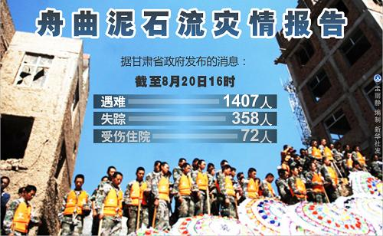

Slide 5
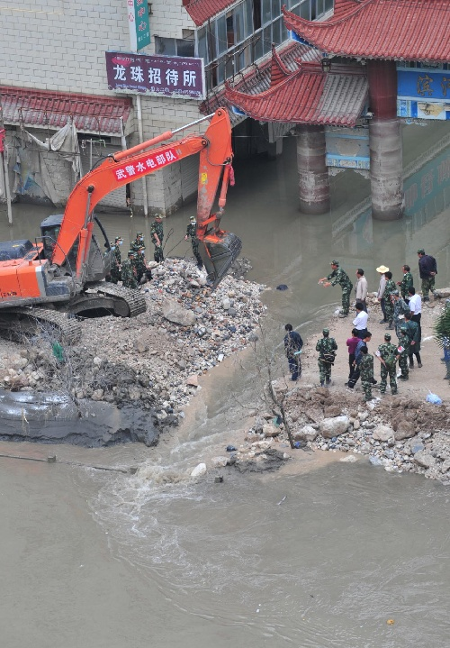
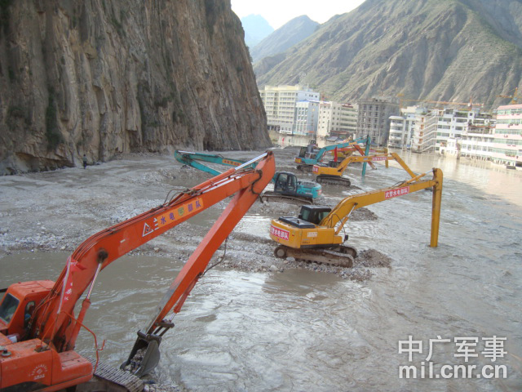
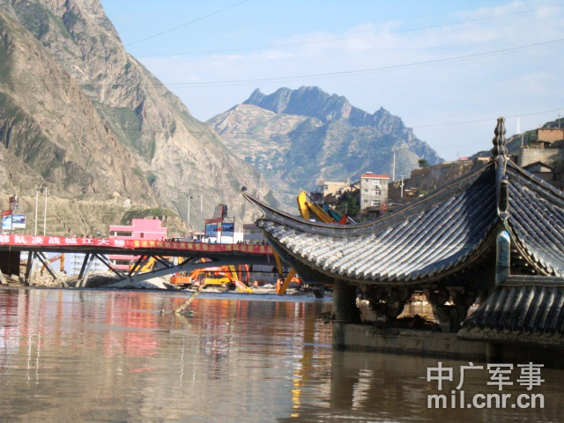
Landslide dam caused water level rise

Slide 6
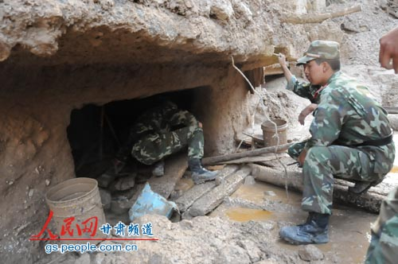

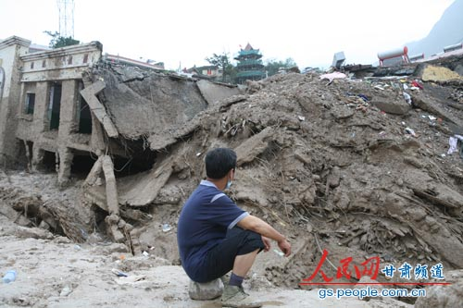
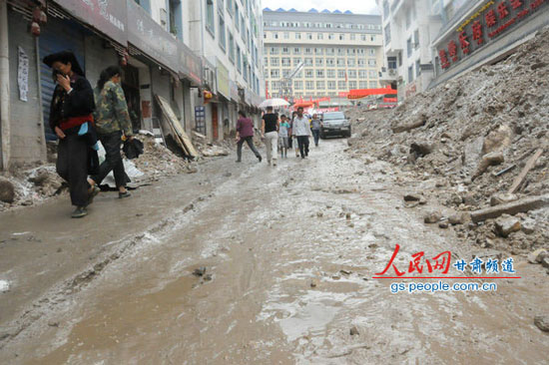

Slide 7
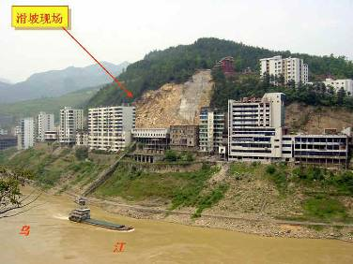
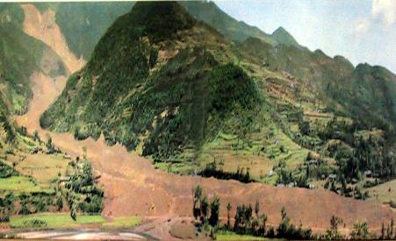
Slope failure in Wulong conty of Chongqing City
Slope failure in Touzhaigou valley of Yunnan Province

Slide 8
In 2002, China initiated nation-wide comprehensive project on flash flood and debris flow disaster prevention.
The Ministry of Water Resources, the Ministry of Land Resources, China Meteorological Administration, The Ministry of Construction, the Ministry of Environmental Protection work together to carry out National Planning on Flash Flood and Debris Flow Disaster Prevention

Slide 9
According to the planning, 1836 counties in 29 provinces (cities), has the tasks for flash flood and debris flow disaster prevention.
The areas of these regions amount to 4.65 million km³
And there are 0.56 billion residents living in these area.
Nation-wide flash flood and debris flow risk map are worked in 2006.

Slide 10
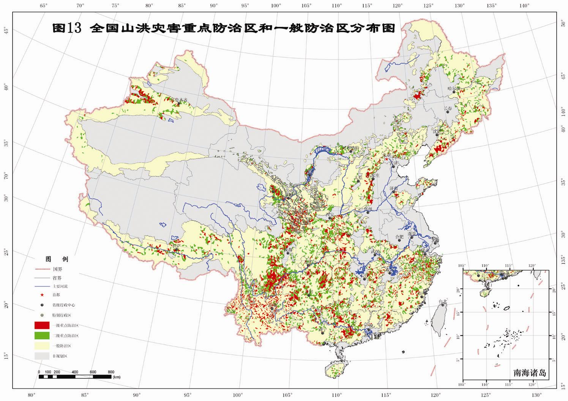

Slide 11
Knowledge generalization and training
Non-structural Measures
Monitoring, communication
and warning system
Preparatory schemes, methodology for
disaster prevention and exercises
Resettlement
Policies and regulations
Management

Slide 12
Treatment of flash flood Valley
Structural Measures
Treatment of debris flow valley
Landslide treatment
Rehabilitation of dams with
deficiencies
Soil and water conservation

Slide 13
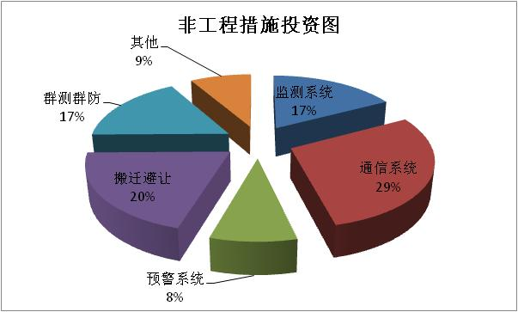
Total investment: 187 billion Yuan (30 billion US$);
Non-structural measures: 53.9 billion Yuan.
Non-structural Measures
Items | Ration of Costs
Monitoring | 17%
Communication | 29%
Warning | 8%
Resettlement | 20%
Person-person help system | 17%
Others | 9%
Total | 100%

Slide 14
Monitoring system
Automatic rainfall gage
  grid dimension:10-20km; 20-40km
Simple rainfall gage for home usage
Water level
Hydrological stations
Movable hydrological stations

Slide 15
Communication system
No. | Items | Contents
1 | Data transfer system for auto-rainfall gage, water level, hydrological data | System for data transfer. Instrument to prevent thunder attack.
2 | Main communication line between management units of different level. | Intra-net
3 | Transfer system of warning messages | Telephone system, ultra short wave system, ADSL line, Fax, mobile phone, satellites-based phone, warning instruments, broadcast, and available alarm instruments
4 | Data collection and sharing platform | Data receiving instruments, computer system, data base.

Slide 16
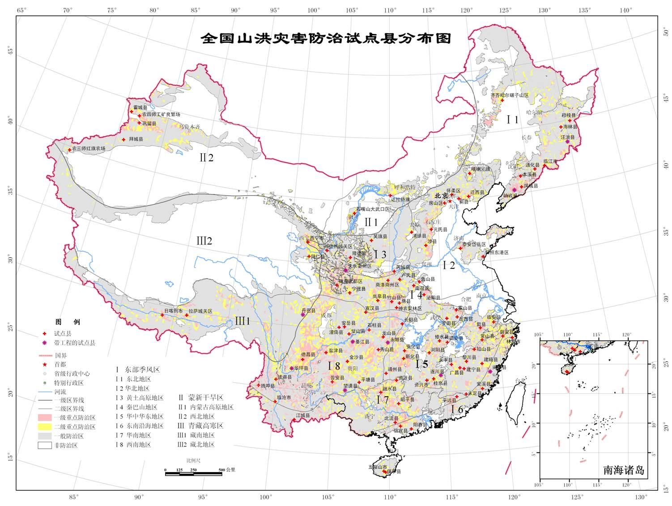
Pilot projects in 103 counties including 1413 towns and villages have been accomplished and gotten great achievements

Slide 17
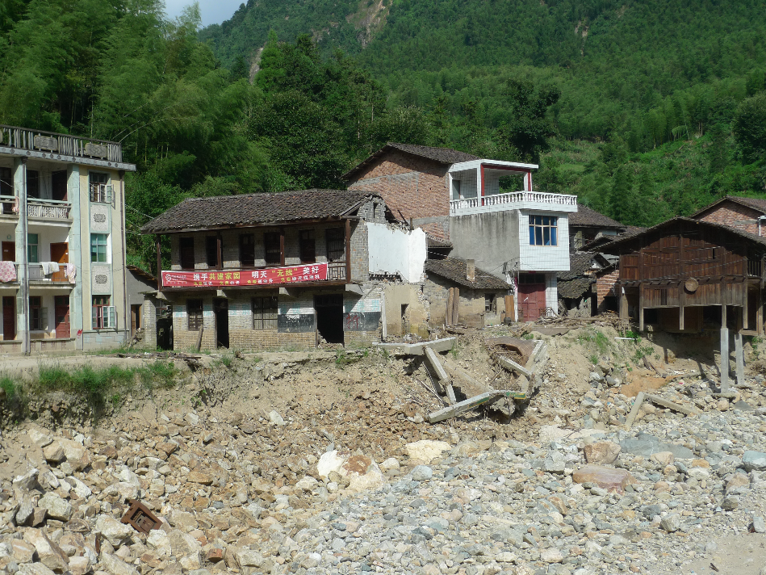
Houcun village in Lichuan county, Jiangxi province
Severe debris flow
No life lose (benefits from non-structural measures)

Slide 18
Rainfall monitoring data
of provincial level
Meteorological
Rainfall and flood data
Meteorological
Rainfall and flood data
Headquarter of provincial level
County level
Warning based on person-person model
Rainfall monitoring data
from local sites
Warning system platform
Heavy rainfall
emergency
flood
town
village
WG
Family
Reservoir /pool

Slide 19

Intranet of mobile phone
Short message
GSM
GPRS
server
GGSN
DDN
Internet
GRE tunnel
GPRS/GSM
Terminals
GSM terminals
receiver
RTU
Data collection terminals
server
Monitoring station
Data processing
Central Receiving station
Communication system based on GPRS

Slide 20


Solar energy board
Communication terminals
Charge controller
Rainfall gage
Terminals for remote monitoring
Electricity Storage

Slide 21
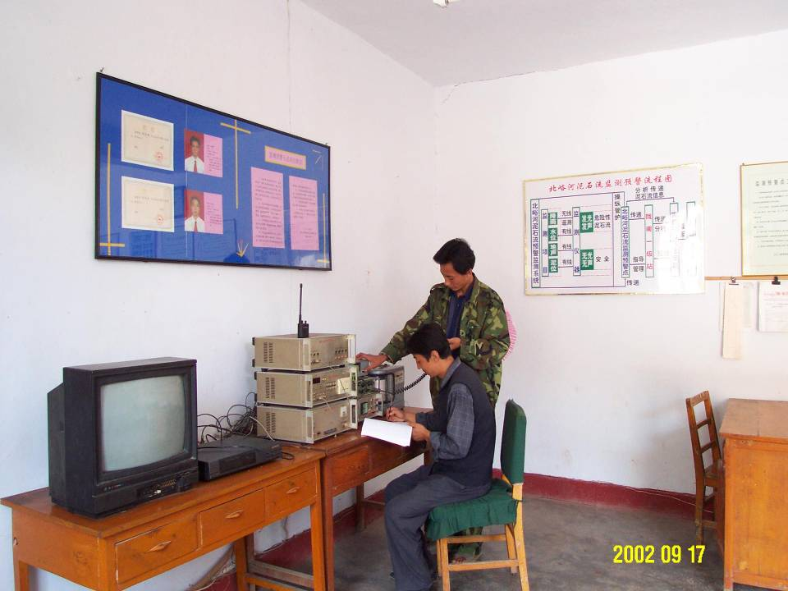

Slide 22

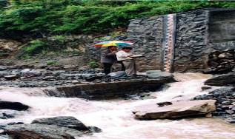
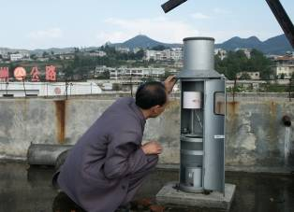
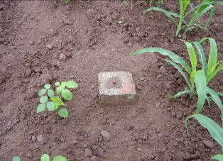
Routine observation
Cracks
Debris flow
Rainfall gage
Displacement

Slide 23
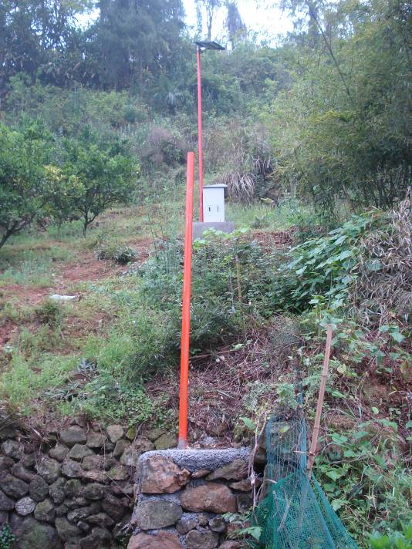
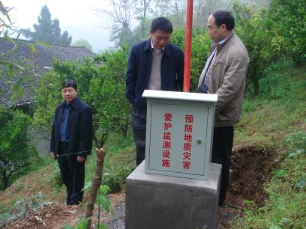
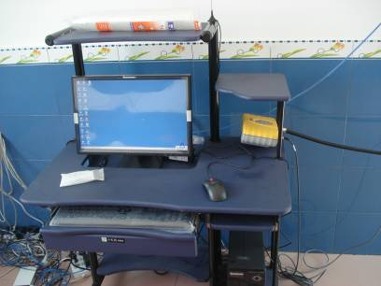

Slide 24
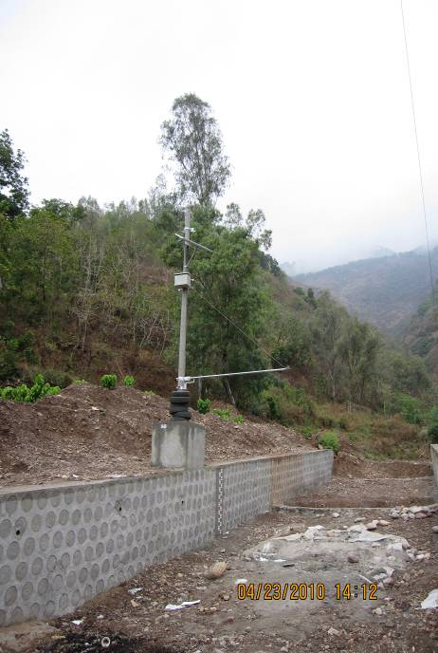
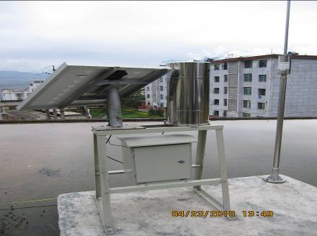

Slide 25

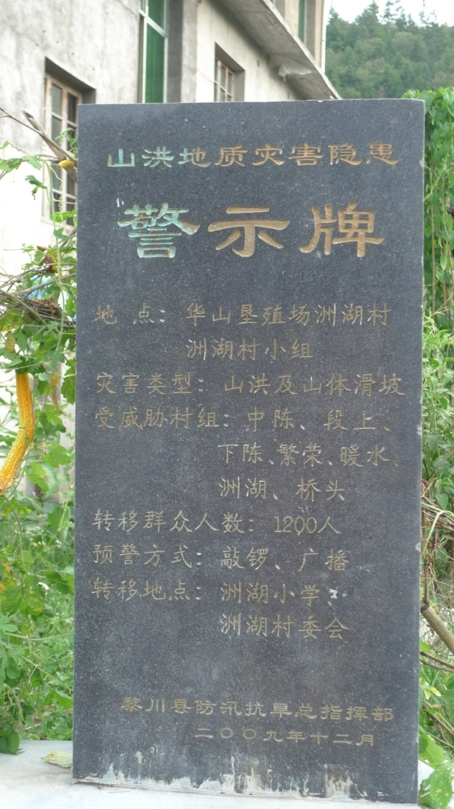
Water level monitoring
Warning board for potential disaster

Slide 26
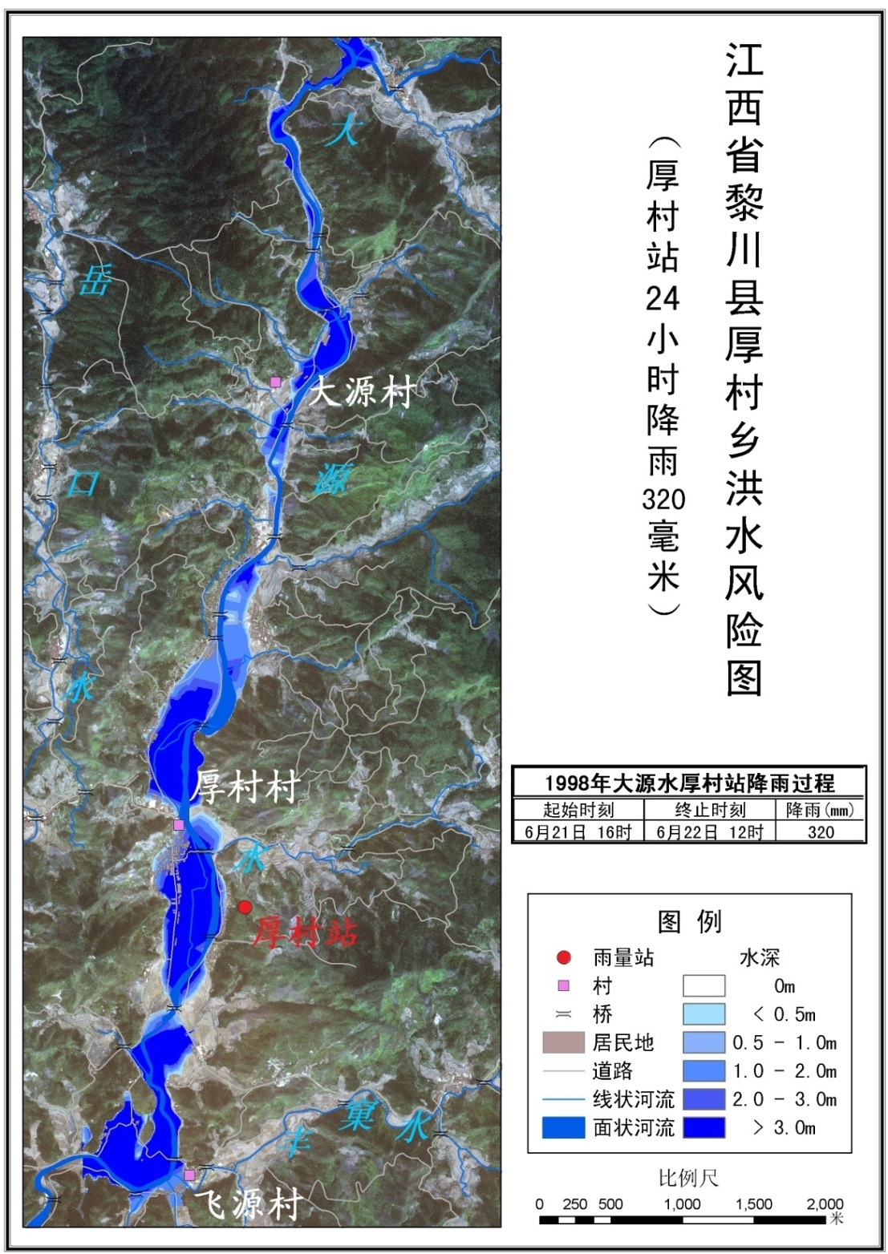
A sample of the flood inundation depth map
The flood inundation depth is divided into 5 grades with different colors.
Some additional data such as rainfall data, legends, and scale etc.
Figure 2: Flood Hazard Map

Slide 27
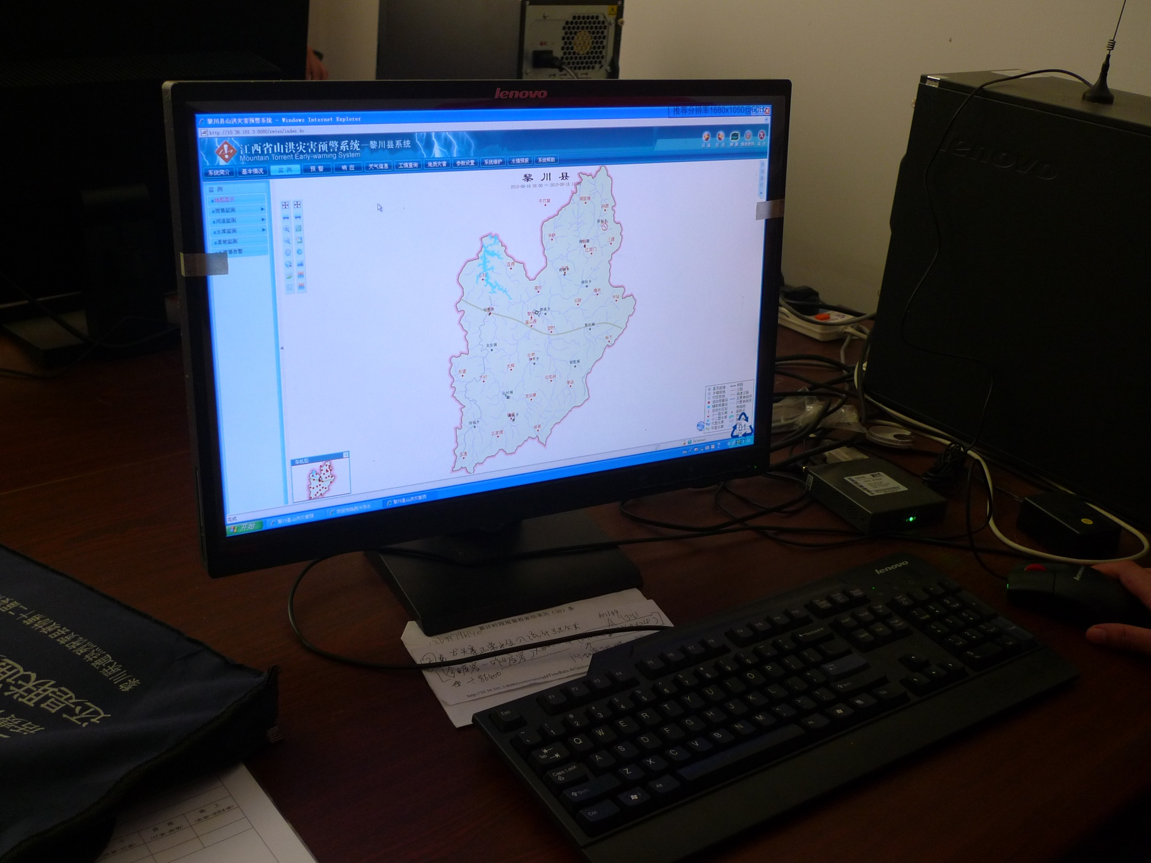

Slide 28
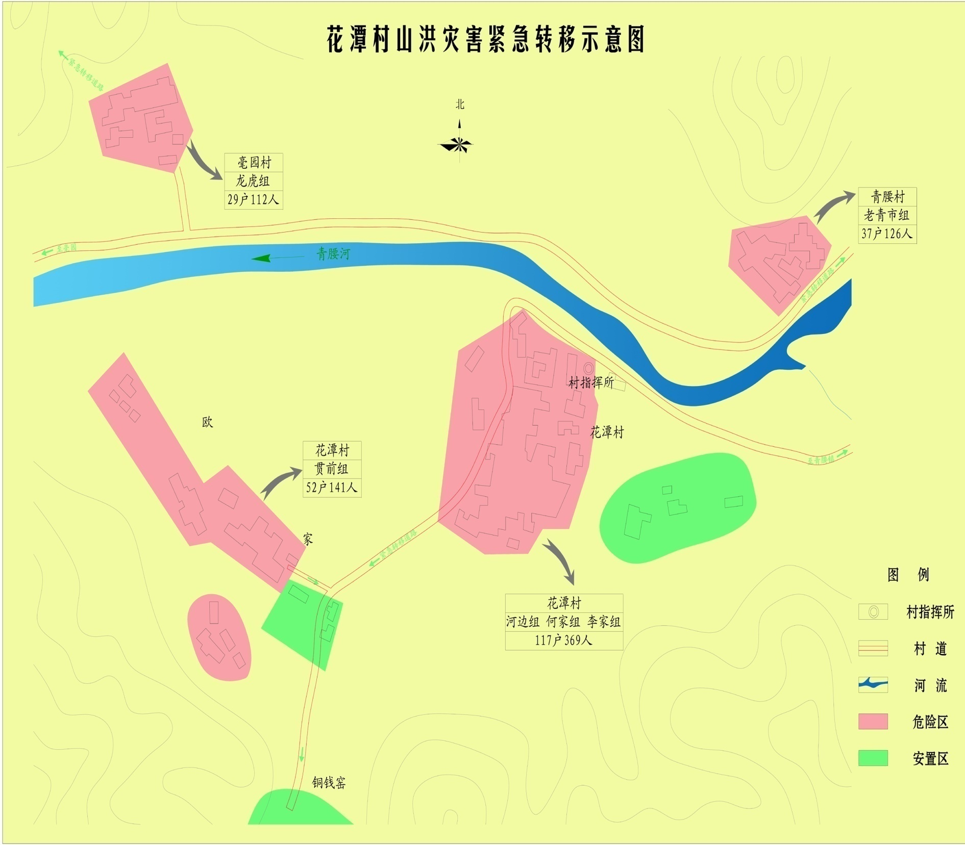
Roadmap for evacuation

